Slide 1
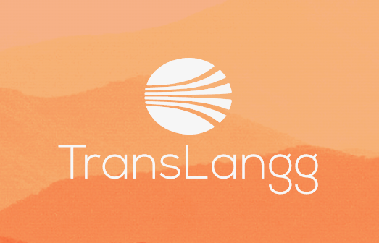
TransLangg: Your Global Transcription
and Translation Solution
Team Members:

Slide 2
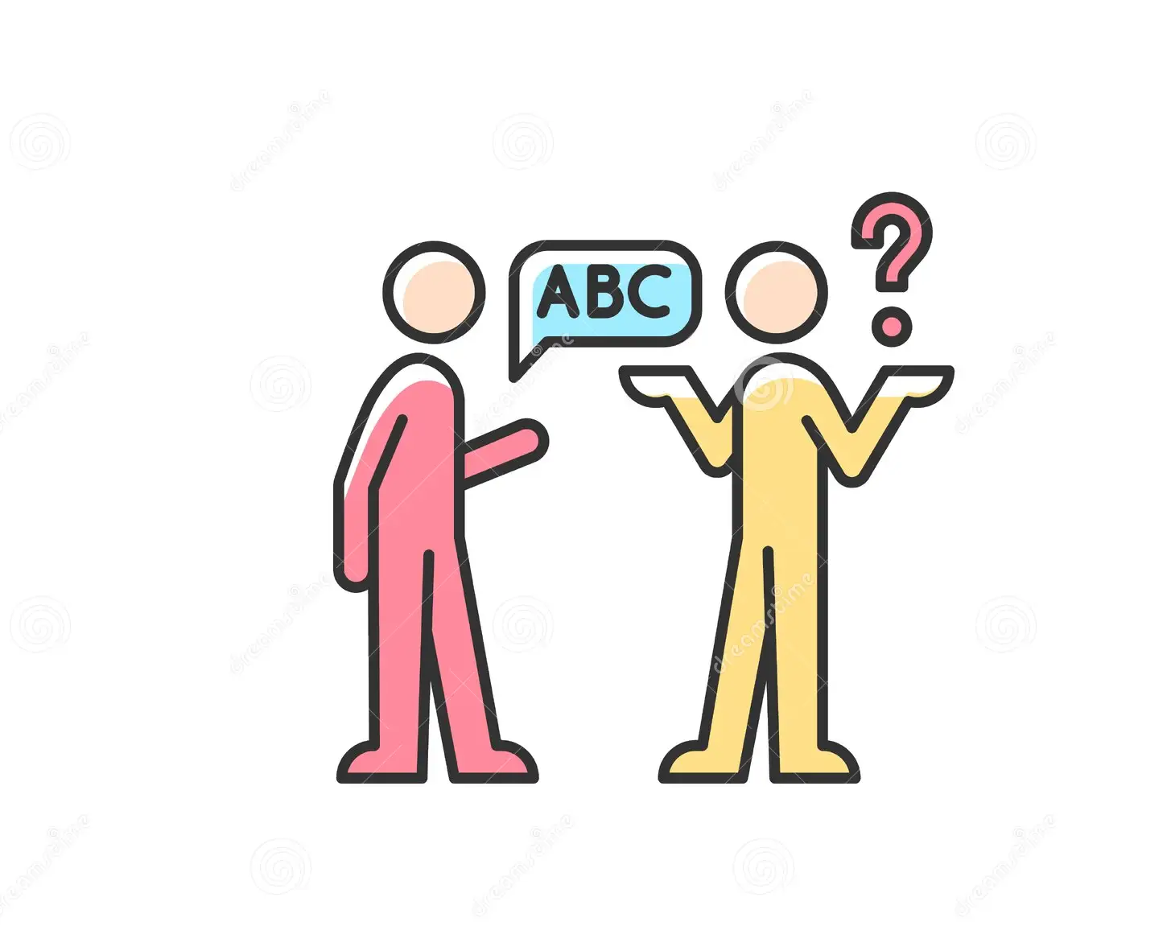
TransLangg: Your Global Transcription
and Translation Solution
This presentation introduces TransLangg, a web-based platform that offers automated document transcription and translation services. It explores the need for cross-language communication, how the platform works, its value propositions, market potential, business model, and development team.

Slide 3
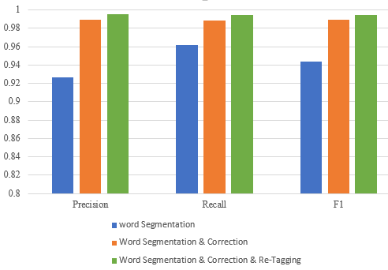
Target Market
Researchers and Academics: Researchers and academics from various fields who need to transcribe interviews, lectures, or research data for analysis and publication.
Journalists and Media Professionals: Journalists and media personnel who require transcription services for interviews, speeches, and news reports to enhance content production and reporting.
Content Creators and Podcasters: Content creators and podcasters who seek to transcribe their audio content into text for repurposing, SEO optimization, and content creation.
Businesses and Corporations: Businesses and corporations that need transcription services for meetings, customer support calls, and internal communication, improving documentation and information management.
Language Learners and Educators: Language learners who use TransLangg for language practice and educators who create transcriptions for teaching materials in diverse linguistic contexts.

Slide 4
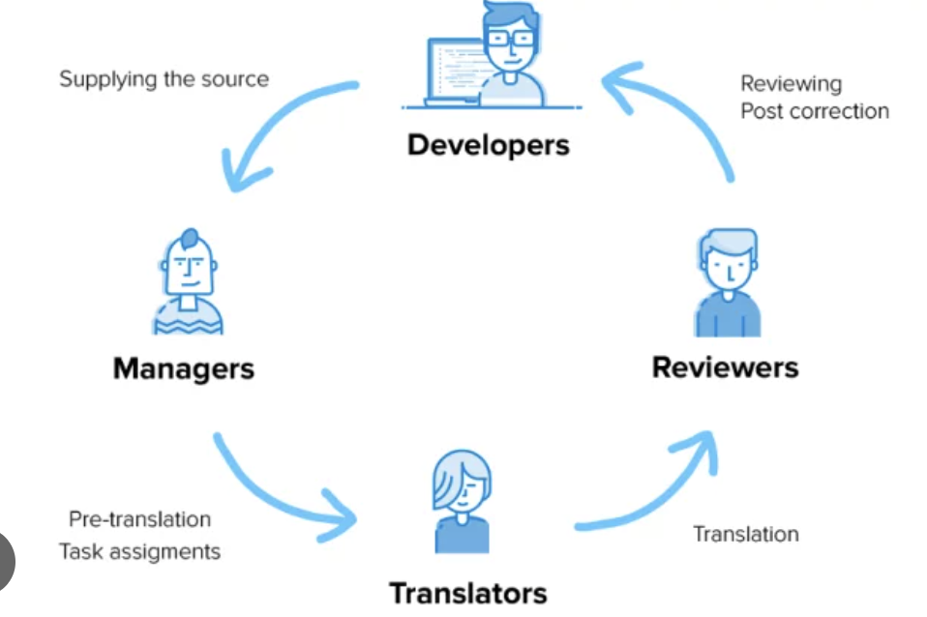

Slide 5
Value Propositions
Time and Effort Savings through automated transcription
Multilingual Support
High Accuracy and Quality via Whisper ASR model
Error Handling and Accountability through logs transcription times and errors
Efficient Content Management and Scalability
User Control over target language for transcription
Continuous Improvement through Feedbacks

Slide 6
The Pain being addressed
The pain points associated with language barriers, time-consuming manual transcription, and the need for efficient content analysis. Users often grapple with the challenge of understanding or communicating in languages they are not proficient in. extracting meaningful insights, sentiments, or entities from extensive text content like audios/videos is complex; TransLangg eases this pain by providing an automated transcription solution that is efficient, multilingual, and adaptable to user preferences, benefiting researchers, journalists, businesses, and learners alike.

Slide 7
Our Solution
TransLangg leverages the Whisper ASR model to fix the pain of manual audio transcription by providing an efficient, accurate, and user-controlled solution. It eliminates the challenges associated with time-consuming manual transcription, language barriers, errors, and scalability issues. Users benefit from enhanced productivity, quality, and accountability, making TransLangg the go-to platform for their transcription needs.

Slide 8
Key Winning Features
Automated Transcription:
Benefit: Saves time and effort through automated conversion of audio/video to text.
Value: Enables efficient content creation and analysis.
Multilingual Support:
Benefit: Allows transcription in multiple languages based on user input.
Value: Facilitates transcription in various languages, addressing the needs of a diverse, global user base.
Advanced Voice Recognition:
Benefit: Utilizes high-accuracy voice recognition APIs.
Value: Ensures precision in transcriptions for professional use.
Transcription History Management:
Benefit: Maintains a record of transcriptions that have already been processed.
Value: Prevents redundant transcription of the same content, optimizing resource usage.
User-Friendly Interface:
Benefit: Offers an intuitive and easy-to-use interface.
Value: Improves user experience for accessibility.

Slide 9
Why our design makes a winner for the target use cases?
User-Centric Approach: The design focuses on user needs, providing an intuitive and user-friendly interface for seamless interaction. This user-centric approach ensures that individuals, regardless of technical expertise, can easily navigate and leverage the platform.
Efficiency through Automation: The integration of the Whisper ASR model enables rapid and accurate transcription, significantly enhance efficiency. By leveraging advanced voice recognition and machine translation, the platform streamlines tasks that are traditionally time-consuming, enabling users to focus on higher-value activities.
Multilingual Accessibility: The integration of machine translation APIs addresses the global nature of communication. Users can effortlessly translate content into multiple languages, breaking down language barriers and catering to a diverse audience. This feature is particularly beneficial for researchers, journalists, and businesses with international reach.
Minimized Errors and Accountability: By automating the transcription process, TransLangg reduces the risk of transcription errors common in manual processes. The error handling and logging features ensure that users can identify and rectify any issues that may arise during transcription, maintaining a high level of accuracy and accountability
Post-Launch Evaluation: The commitment to post-launch evaluation, including user adoption analysis, feedback assessment, and identification of areas for improvement, ensures the platform remains responsive to user needs and market dynamics.

Slide 10
Capabilities
Automated Transcription: TransLangg offers automated transcription of audio content using the powerful Whisper ASR model, significantly reducing the time and effort required for manual transcription.
Multilingual Support: Users can transcribe content in a wide range of languages. The platform supports user-defined language selection, ensuring language flexibility and breaking down language barriers.
Language Flexibility: TransLangg allows users to specify the target language for transcription, offering control and adaptability for working with content in their preferred language.
Error Handling and Accountability: TransLangg logs transcription times and potential errors, ensuring transparency and accountability in the transcription process.
Scalability and Adaptability: TransLangg is designed to efficiently scale with a growing user base, ensuring responsive performance even with increased demand.
User Control: Users have the power to choose the target language and transcribe content according to their linguistic preferences, empowering them to work in the language they are most comfortable with.
Efficient Content Retrieval: TransLangg generates a zip package of transcriptions, making it convenient for users to access and manage their transcribed content.
Continuous Improvement: The platform is committed to ongoing enhancement, with a feedback loop, post-launch evaluation, and agile development approach to meet changing user needs and technological advancements

Slide 11
Justifications
Efficiency and Productivity: Automated transcription using the Whisper ASR model significantly reduces the time and effort required for transcription, enhancing user efficiency and productivity.
Global Accessibility: Multilingual support and user-defined language selection make TransLangg accessible to a diverse global audience, ensuring that language is not a barrier to transcription.
User-Centered Approach: User control over target language empowers users to work in the language of their choice, improving user satisfaction and comfort.
Enhanced Accuracy: The Whisper ASR model minimizes transcription errors, increasing the accuracy and reliability of transcribed content.
Accountability: Error handling and logging features promote transparency and accountability in the transcription process, fostering trust among users.
Resource Optimization: Transcription history management prevents the duplication of transcription efforts, optimizing time and resources for users.
Long-Term Adaptability: User feedback and continuous improvement mechanisms guarantee that TransLangg remains adaptable and responsive to evolving user needs, ensuring its longevity and relevance.

Slide 12
Current Status of the Initial Prototype
The current status of the initial prototype of TransLangg is in the development phase. The team has successfully integrated the Whisper ASR model for automated transcription, and the platform supports multiple languages, providing users with language flexibility. It allows users to select their preferred target language for transcription. Additionally, features like error handling, accountability through logging, and efficient transcription history management are functional
It's important to note that while the initial prototype of TransLangg has made significant strides in terms of functionality, it is still in the early stages of development. Further testing, refinement, and user feedback are essential to fine-tune the platform and ensure it meets the high standards expected by its target user base, including researchers, journalists, content creators, and businesses. The development team is dedicated to delivering a robust and user-friendly final product.

Slide 13
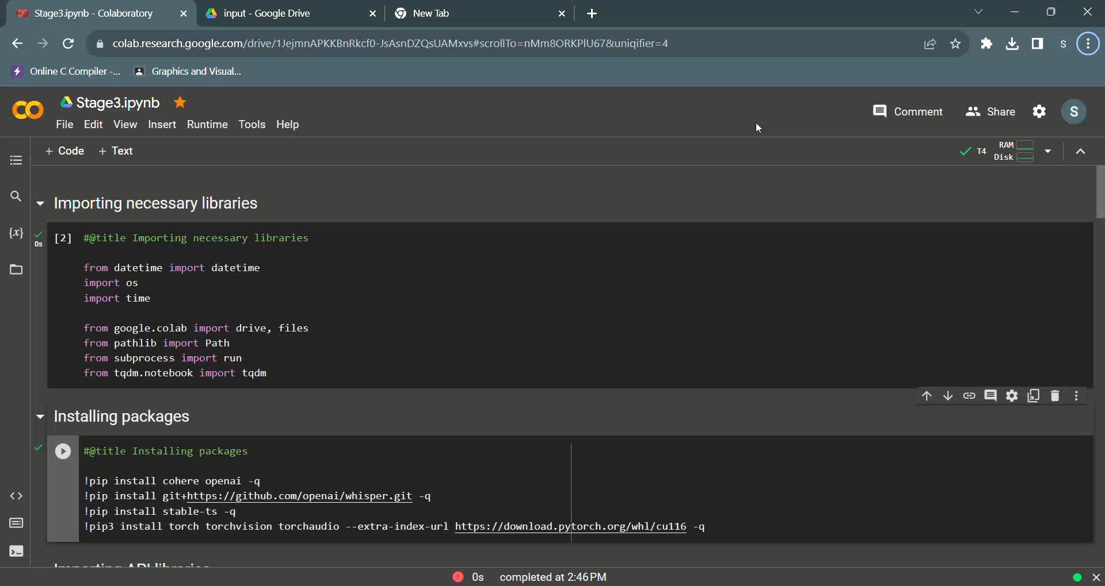

Slide 14
Market Potential
Market Demand
High demand across industries
Competitive Advantage
We add new value to already booming market
Offering a comprehensive solution with Whisper ASR model

Slide 15
Our Business Model
Data Monetization: Aggregated, anonymized user data may be used for research and insights, generating additional revenue.
Subscription-based model or pay-per use
Ad-Supported Free Plan or freemium
Exploring partnerships, licensing APIs, or premium features
Custom Enterprise Plans tailored to specific needs, including API access and volume discounts

Slide 16
Team Members and Contributions
18/10/2023: Conceptualization and Planning 1. Member 1 (Project Manager): Led the conceptualization and planning stage, defining the project scope, objectives, and timelines. Created a comprehensive project plan, outlining tasks and responsibilities for each team member. Ensured alignment with the client's requirements and expectations.
19/10/2023: Market Research and Analysis 2. Member 2 (Market Research Analyst): Conducted in-depth market research to identify target demographics, competitors, and potential opportunities. Analyzed data and produced a market analysis report to inform the project's direction.
20/10/2023: Design and Prototyping 3. Member 3 (UI/UX Designer): Designed the application's user interface, focusing on user experience and visual aesthetics. Created wireframes and prototypes for client review and feedback.
21/10/2023: Construction/Integration of APIs 4. Member 4 (Backend Developer): Led the construction and integration of APIs, ensuring the backend infrastructure was robust, scalable, and secure. Worked on API development, database integration, and data management.

Slide 17
Team Members and Contributions
22/09/2023: Testing and Quality Assurance 5. Member 5 (QA Engineer): Conducted rigorous testing and quality assurance checks on the application. Identified and reported bugs, inconsistencies, and usability issues. Collaborated with the UI/UX designer and backend developer to ensure a seamless user experience.
26/09/2023: Monitoring and Maintenance. Member 1 (Project Manager): Oversaw the monitoring and maintenance phase, ensuring that the application was running smoothly in the production environment. Implemented monitoring tools and processes for performance optimization.
27/09/2023: Feedback and Iteration. Member 2 (Market Research Analyst): Gathered feedback from users and conducted surveys to collect input on the application's usability and performance. Provided insights to the team for iterative improvements.
Throughout the entire development process, all team members collaborated closely, communicated regularly, and adapted to changes and feedback to ensure the successful development and delivery of the application. This collaborative approach facilitated a more efficient and effective development cycle..

Slide 18

Conclusion
TransLangg is a cutting-edge platform reshaping how we engage with audio and video content. Its standout features, such as automated transcription, and multilingual translation, cater to diverse user needs. The user-friendly interface, robust security, and scalability enhance the overall experience. TransLangg not only bridges language gaps but also delivers organized content and continuous improvement based on user feedback. Positioned as an essential tool, TransLangg offers efficient, precise, and accessible transcription and translation solutions for a global audience.

Slide 19
Implementation Phase Planning
Team Kickoff:
Assemble the development team, clarify roles, and set expectations.
Conduct a team kickoff meeting.
Communicate project goals and timelines.
Backend Development:
Build the server infrastructure, implement APIs, and set up the database.
Develop server-side logic.
Integrate voice recognition and machine translation APIs.
Set up a robust database system.
Frontend Development:
Develop the user interface for seamless user interaction.
Create responsive and intuitive UI elements.
Implement features for file uploads and user interactions.
AI Integration:
Integrate advanced AI features for voice recognition and transcription using Whisper ASR model.
Connect with voice recognition APIs.
Testing:
Conduct thorough testing for functionality and security.
Perform functional testing of features.
Conduct security testing and address any vulnerabilities.

Slide 20
Implementation Phase Planning
User Onboarding:
Provide resources for user onboarding and support.
Create onboarding tutorials.
Establish a customer support system.
Monitoring and Maintenance:
Implement tools for ongoing monitoring and maintenance.
Set up monitoring for performance and security.
Establish a process for regular maintenance and updates.
Feedback Loop:
Continuously gather user feedback for future improvements.
Implement mechanisms for user feedback.
Post-Launch Evaluation:
Evaluate the success of the platform post-launch.
Analyze user adoption and feedback.
Identify areas for further improvement.
The development stages are tasks involved in creating and maintaining an application, incorporating team kickoff, backend and frontend development, AI integration, testing, deployment, user onboarding, monitoring, feedback collection, and post-launch evaluation.

Slide 21
Technical Validation
a. Prototype Testing: Test a working prototype to verify that it functions as expected. This can involve rigorous testing to identify and fix technical issues.
b. Quality Assurance: Implement quality control processes to ensure that the product or service is reliable, secure, and free from critical bugs or vulnerabilities.
c. Scalability Testing: Check whether your product or service can handle an increased workload as you scale up. This involves load testing, stress testing, and performance optimization.
d. Compliance and Regulations: Ensure that your product complies with industry-specific regulations and standards. This is particularly important in sectors like healthcare, finance, or data privacy.
e. User Acceptance Testing (UAT): Involve users or stakeholders to validate that the product meets their expectations and requirements.
f. Documentation: Create comprehensive technical documentation that explains how the product works, how it can be maintained, and any troubleshooting steps.
g. Security Assessment: Perform security audits to identify and mitigate vulnerabilities to protect your product from cyber threats.

Slide 22
Market Entry
Once the technical validation is complete, you can enter the market. Market entry involves introducing your product to your target audience. Here's how it works:
a. Market Research: Conduct in-depth market research to identify your target audience, competitors, and market trends. This data helps refine your marketing and sales strategies.
b. Go-to-Market Strategy: Develop a strategy for how you will introduce your product to the market. This includes pricing, distribution channels, and marketing campaigns.
c. Customer Acquisition: Implement sales and marketing activities to attract your first customers. This could involve online advertising, content marketing, or traditional sales methods.
d. Customer Support: Ensure you have adequate customer support in place to address inquiries, issues, and provide assistance to early customers.
e. Feedback Collection: Continuously gather feedback from your early customers to identify areas for improvement and refine your product or service.

Slide 23
Scaling Up
Scaling up is the phase where you expand your operations to reach a broader customer base. Here's how you can do it:
a. Production and Operations Scaling: Increase your production capacity and operational capabilities to meet growing demand.
b. Market Expansion: Enter new markets or reach new customer segments to grow your customer base.
c. Team Growth: Hire more employees or team members to support increased workload and customer demand.
d. Technology Scalability: Ensure that your technical infrastructure can handle the growth in users and data. This may require additional servers, databases, or cloud resources.
e. Customer Retention: Focus on retaining existing customers while acquiring new ones. This can involve loyalty programs and continued customer support.
f. Financial Planning: Develop a financial plan to manage increased expenses and revenue growth effectively.
g. Strategic Partnerships: Explore partnerships with other businesses to access new markets or technologies.

Slide 24
Thank you for your time and attention! 🙂

